Slide 1


DIGITAL SIGNAL AND IMAGE MANAGEMENT PROJECT
Davide Brinati – Davide Meloni – Alberto Raimondi
Academic year 2018/2019

Slide 2
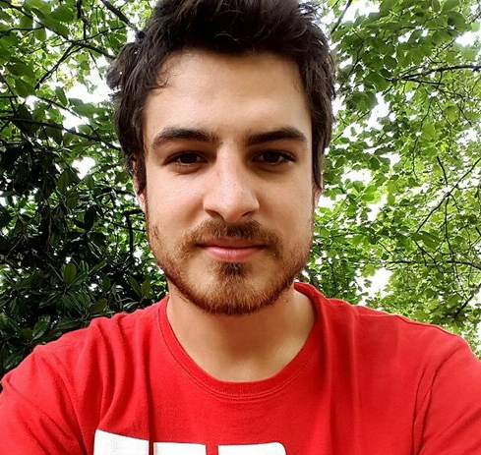


TEAM
Davide Brinati
Alberto Raimondi
Davide Meloni

Slide 3
Agenda
01
Introduction
02
Face Recognition model
03
Language Identification model
04
Image Retrieval

Slide 4
INTRODUCTION

Slide 5

Machine Learning
PROJECT AIM
The goal of this project is to build a recognition system in order to detect ethnicity, sex and language spoken by the user. Thus we have implemented an image retrieval algorithm to match user face with the most similar one in celebrities faces dataset.

Slide 6






OVERVIEW
Face recognition
Image retrival
Language identification
Tools used:

Slide 7
FACE CLASSIFICATION

Slide 8
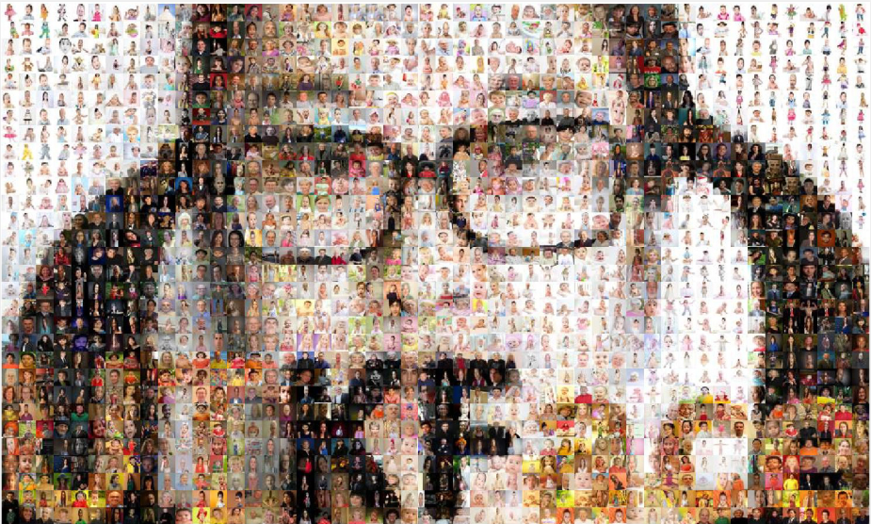
Face Classification: Dataset
To train the model we used UTKFace dataset, which is a large-scale face dataset with long age span (range from 0 to 116 years old). The dataset consists of over 20,000 face images with annotations of age, gender, and ethnicity. The images cover large variation in pose, facial expression, illumination, occlusion, resolution, etc.
Link to the UTKFace dataset

Slide 9
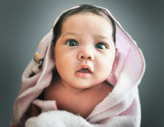
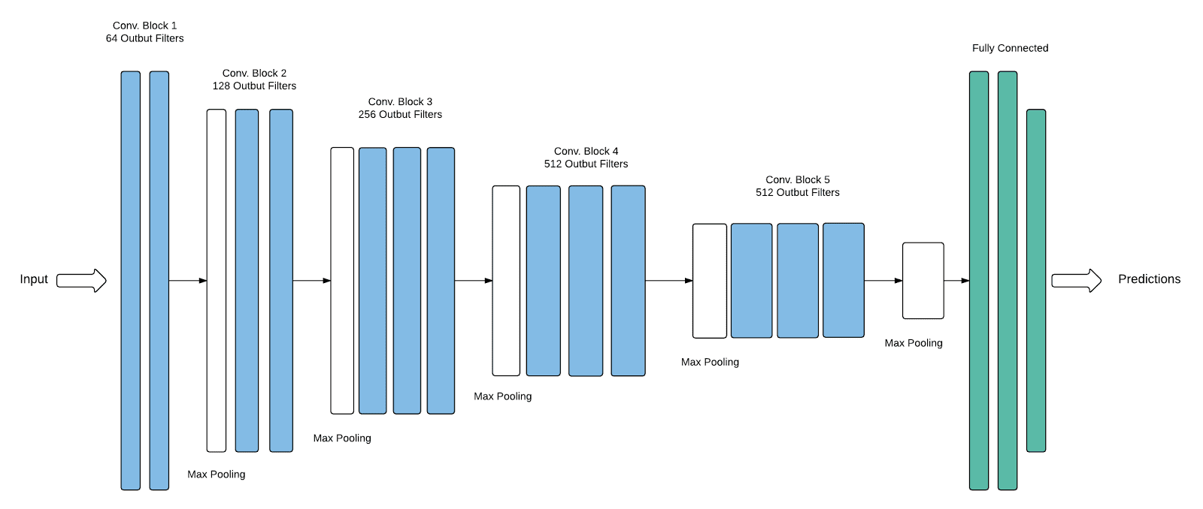
FACE CLASSIFICATION: MODEL
Modern Portfolio Presentation
Our objective is to develope a classifier for ethnicity (four classes: «White», «Black», «Asian» and «Indian») and sex. VGG16 architecture, with pretrained weights on imagenet, was used for this task. Here below the ethnicity recognition net.
WHITE
BLACK
ASIAN
INDIAN
VGG16 architecture with last 5 layers trainable followed by fully-connected with:
1° layer 2048 neurons (act: relu) – 2° layer 1024 neurons (act: relu) – Dropout - 3° layer 512 neurons (act: relu) - 4° layer 252 neurons (act: relu) – Dropout - 5° layer 128 neurons (act: relu) - 6° layer 64 neurons (act: relu) – Dropout - 7° layer 32 neurons (act: relu) - 8° layer 16 neurons (act: relu) - 9° layer neurons (act: softmax)

Slide 10
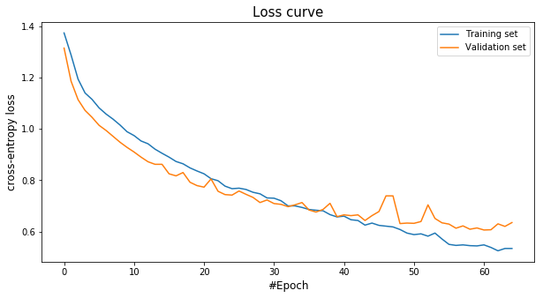
Ethnicity Classification:
Training process
Data augumentation on training:
Image rotation
Width and height shift
Zoom
Shear
Horizontal flip
Trained for 65 epochs on an AWS P3 instance. Loss: categorical crossentropy. Optimizer: SGD (lr = 1e^-4)
Best train accuracy: 0.813
Best validation accuracy: 0.787

Slide 11
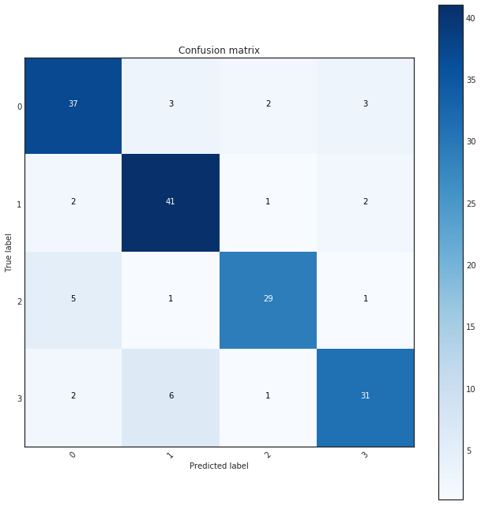
Ethnicity Classification:
Model evaluation
Test accuracy: 0.826
Test loss: 0.509

Slide 12

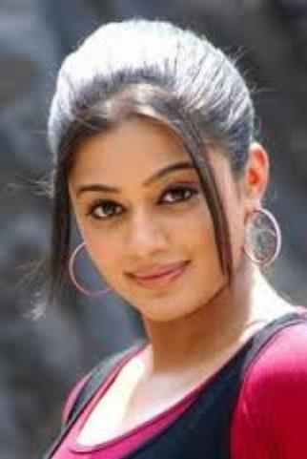
Task: Gender classification
MAN
WOMAN
VGG16 architecture with last 5 layers trainable followed by fully-connected with:
1° layer 1024 neurons (act: relu) – 2° layer 512 neurons (act: relu) - Dropout - 3° layer 252 neurons (act: relu) –4° layer 128 neurons (act: relu) – Dropout - 5° layer 64 neurons (act: relu) - 6° layer 32 neurons (act: relu) – Dropout - 7° layer 16 neurons (act: relu) - 8° layer 8 neurons (act: relu) - 9° layer 4 neurons (act: relu) - 10° layer 2 neurons (act: sigmoid)

Slide 13
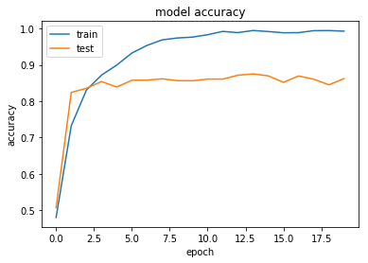
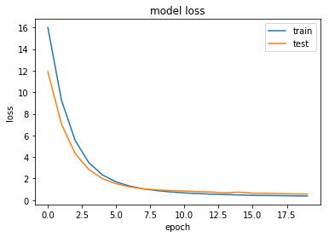
Gender Identification:
Training process
Data augumentation on training:
Image rotation
Width and height shift
Zoom
Shear
Horizontal flip
Trained for 20 epochs. Loss: binary crossentropy. Optimizer: SGD (lr = 1e^-4)
Best train accuracy: 0.994
Best validation accuracy: 0.871

Slide 14
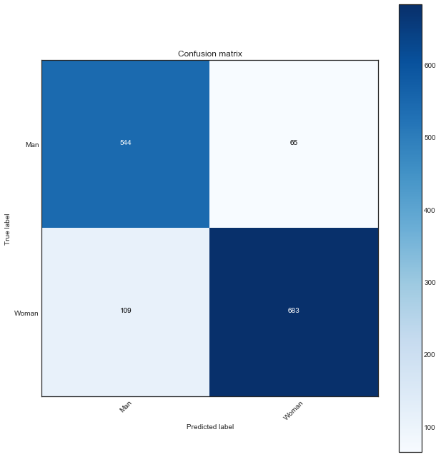
Gender Identification:
Model evaluation
Test accuracy: 0.875
Test loss: 0.609

Slide 15
Language Identification

Slide 16
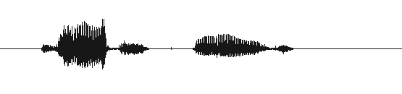

Dataset:
The
VoxForge
archive
VoxForge
VoxForge is a web platform where everyone can upload his audio speech. The archive aims to create a free library for Open Source Speech Recognition Engines. Just because everyone can register himself while reading a book or a speech, the audio files are often noisy and not in a clear voice. There are audio files in many languages, we decided to focus on the six most populated classes: Dutch, English, Italian, Spanish, French and Russian. Each of these idioms collects about 1500 different speakers, we estimate our dataset to store a total of more than 7 days of audio files.
Link to the dataset: http://www.voxforge.org/

Slide 17



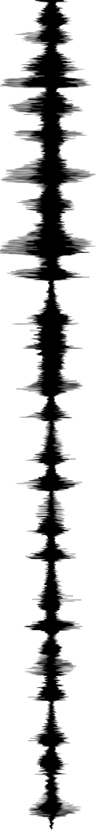
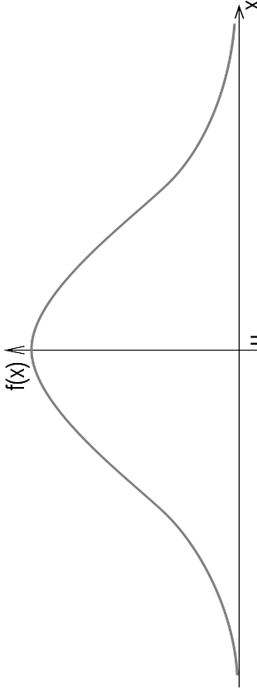



Language Identification: Model
Our task is to develop a classifier able to recognise the language of the speaker, nevertheless we know that our model is neither recurrent or so deep to detect very complex patterns such as the syntax of a language, but we hope it to capture the usual phonems and the typical pronunce of each idiom.
160000x1
64 units
3x3x256
3x3x128
256 units
3x3x32
3x3x64
32x32x32
Conv1D blocks followed from:
- ReLU activation - MaxPooling
- BatchNorm – Spatial Dropout
flatten

Slide 18
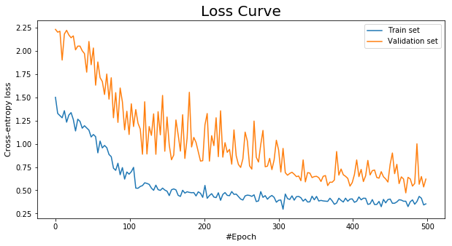
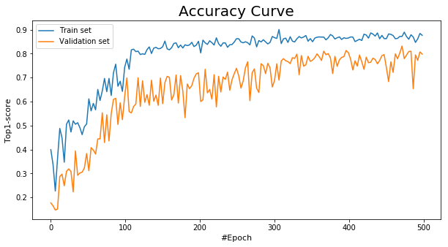
Language Identification:
Training process
500 training epochs on GoogleCloud with Nvidia Tesla K80
Audio sampling rate: 4000 frame/sec
Input audio duration: 4 sec
Loss: categorical cross-entropy
Optimizer: Adam (lr = 1e-4)
Data augmentation techinques:
- audio shifting
- noise addition
- audio stretching
- pitch shifting
New augmented data batch every 3 epochs

Slide 19
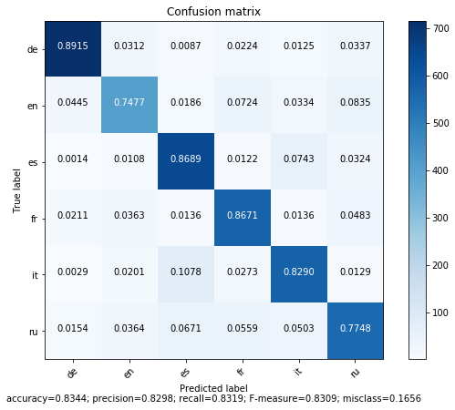
Language Identification:
Model evaluation

Slide 20
Image Retrival

Slide 21
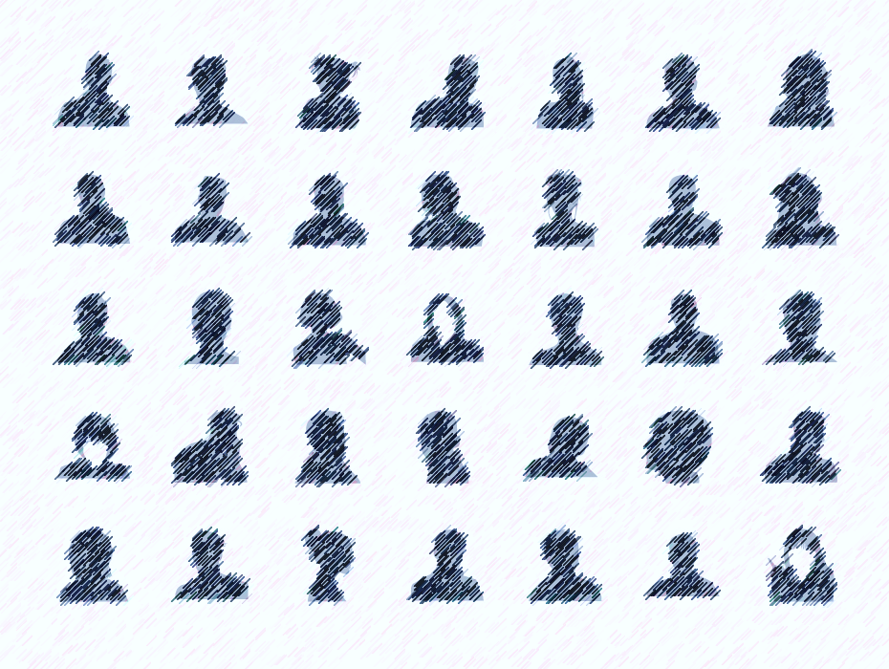
Dataset:
MSRA-CFW: Data Set of Celebrity Faces on the Web
202792 Images of celebrities faces
1587 Celebrities
Faces are in the image but are not cropped

Slide 22
Task
Compute a representation of the image that is invariant to changes of lighting, scenery and position of the subject
Unsupervised learning task as there are no specific label
Multiple possible solutions
Network computes a representation in a 128 dimensional Euclidean space
The more distant the images the more the subjects are different
The network learns an embedding of the features of the face

Slide 23
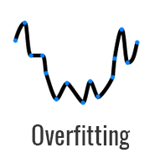
First try
6 CNN blocks with
Convolution 3x3 kernel
Relu Activation
Droput
Maxpool
2 Fully connected block
Affine layer 256 and 128 units
Relu Activation
Linear output

Slide 24
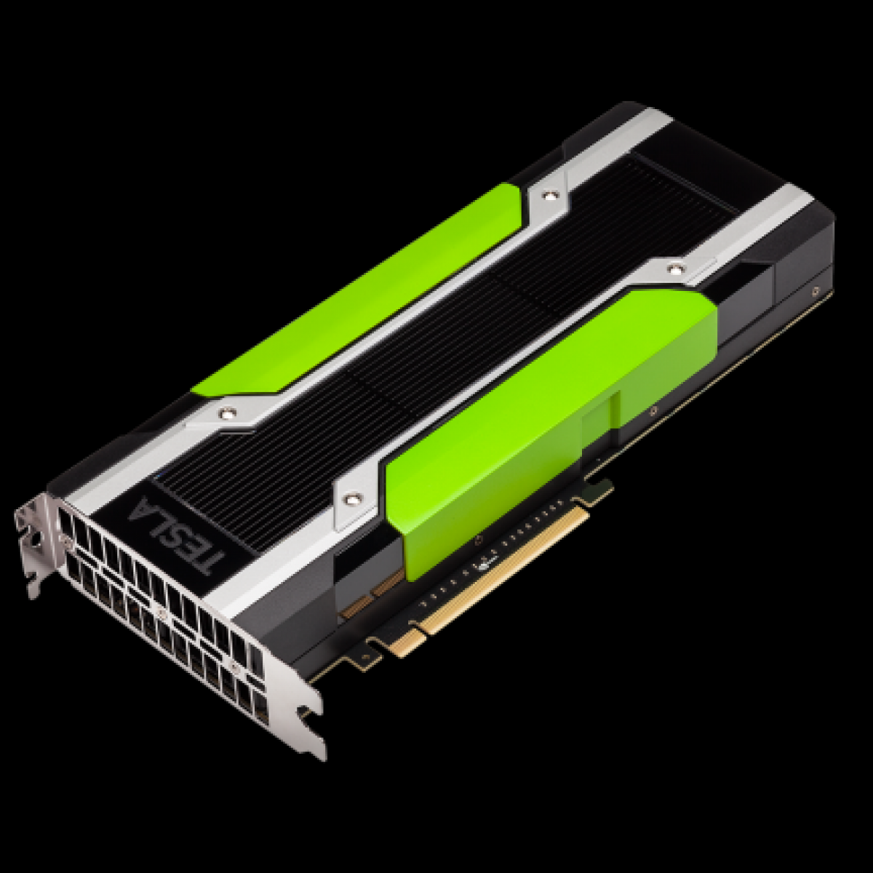
Second try
2 CNN blocks with
Convolution 5x5 kernel
Relu Activation
Batch normalization
Dropout
Maxpool
2 CNN blocks with
Convolution 3x3 kernel
Relu Activation
Batch normalization
Dropout
Maxpool
2 Fully connected block
Affine layer 516 and 256 units
Relu Activation
Linear output

Slide 25
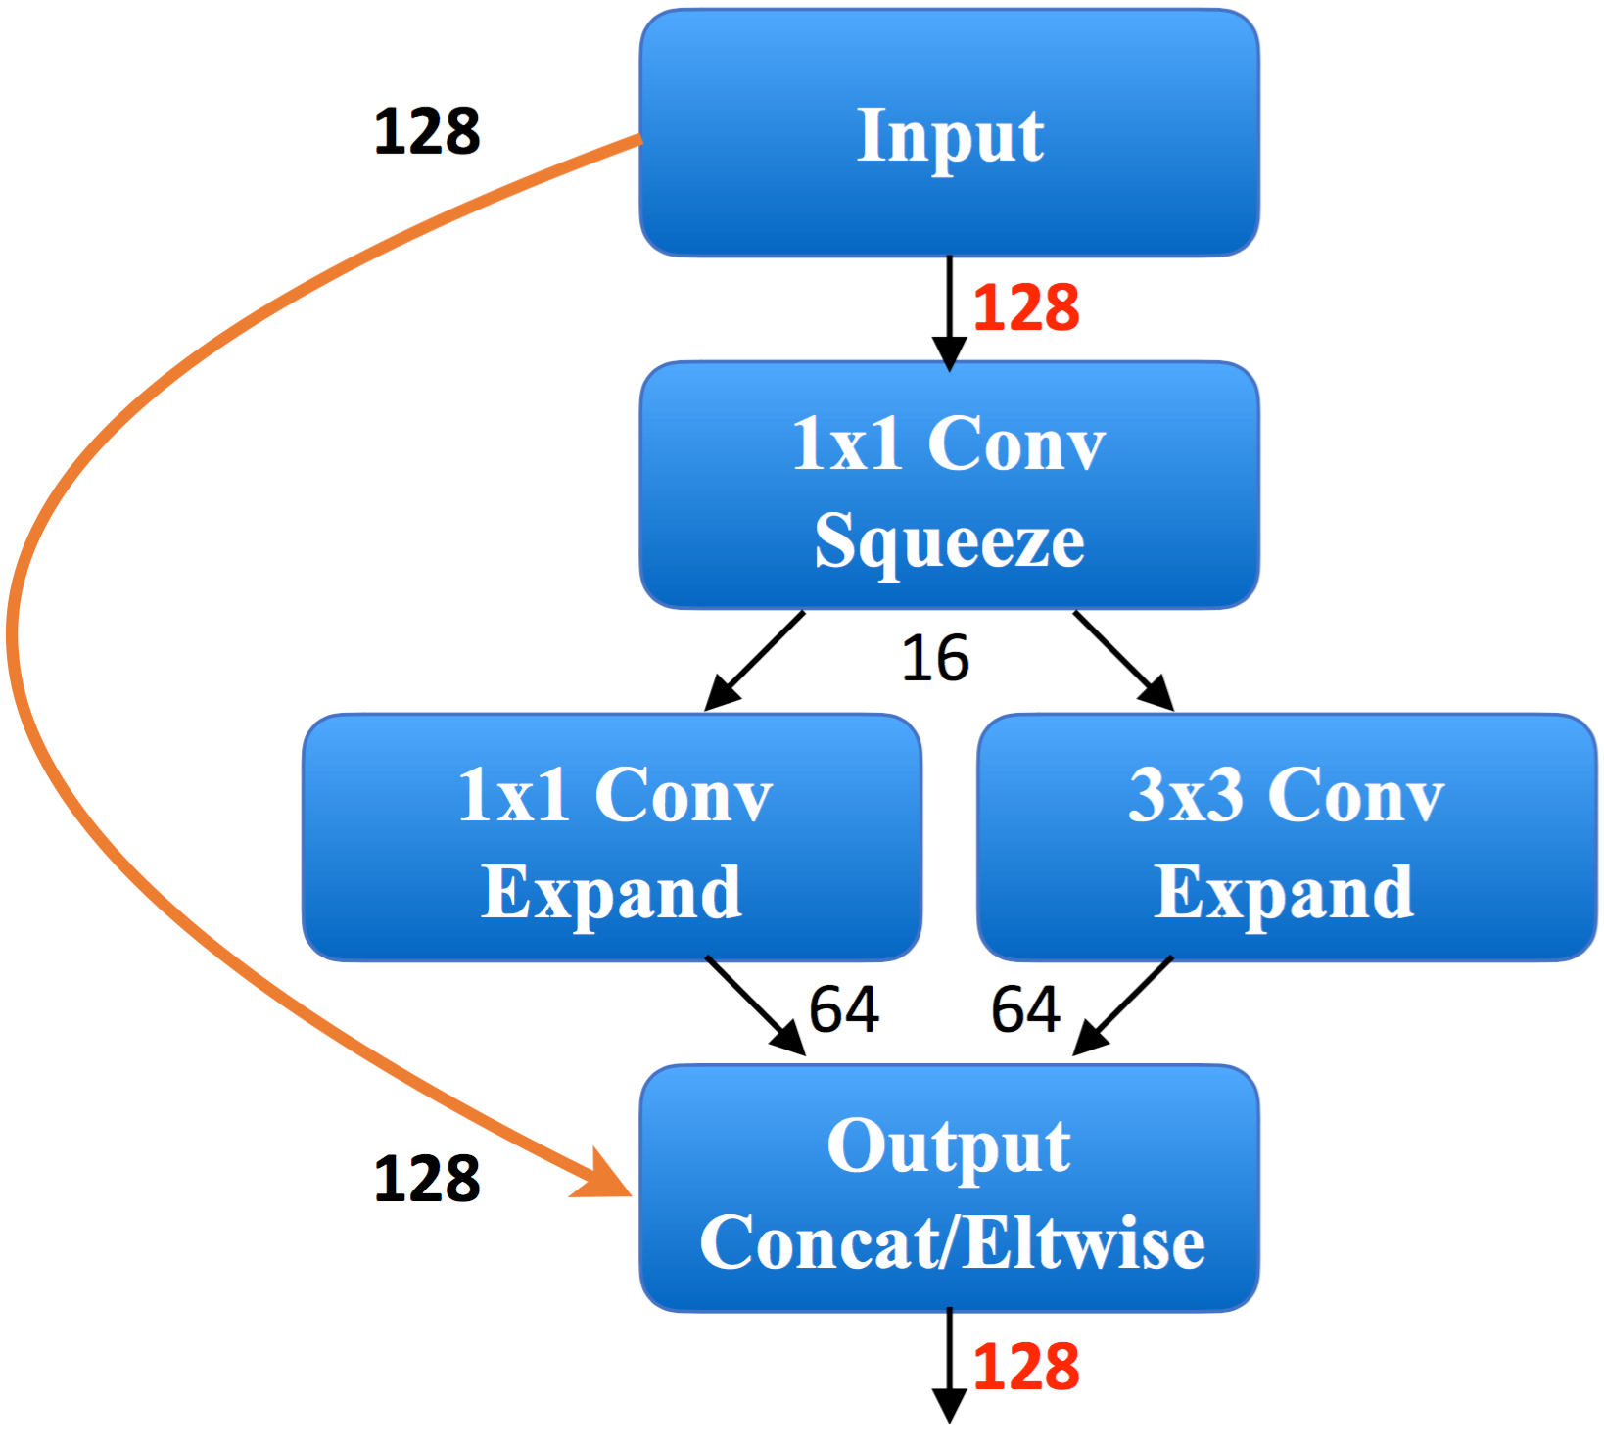
Squeezenet
Very fast
Pretrained on imagenet
9 FIRE Blocks
Fully convolutional
Residual connections
Separated convolutions
Adaptive pooling
Allows any input size
Linear output

Slide 26
Loss
The loss function is the main ingredient of this architecture
gives the model feedback to keep different person distant while keeping different photos of the same actor near
Cannot use cross entropy as we do not have labels
We use a variation of L2 because we are working in an Euclidean space

Slide 27
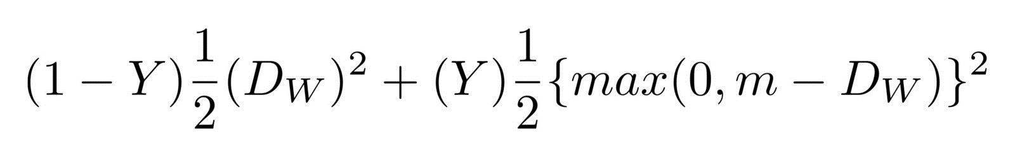
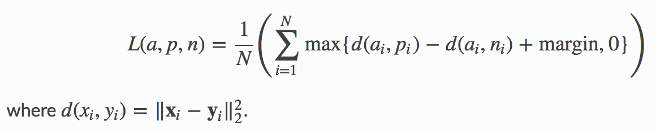
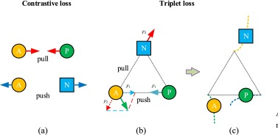
Loss
Contrastive Loss
Triplet Loss

Slide 28
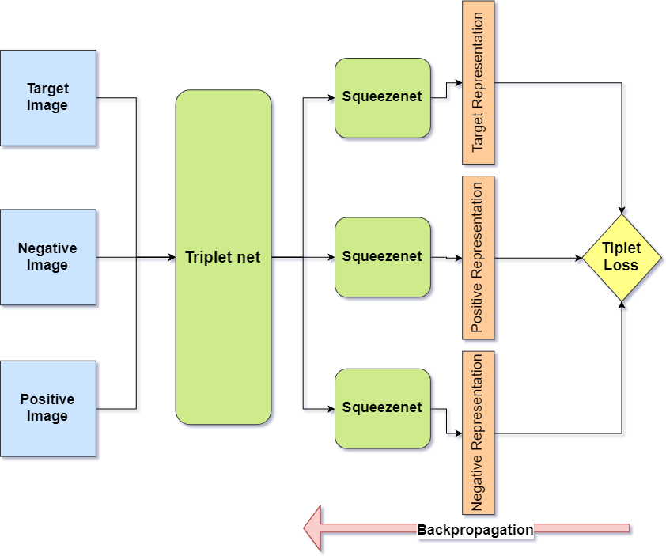

Slide 29
ARCHITECTURE
The network is more hard to train as we have to cache more images to backpropagate every pass
Trained on k80 with 60gb ram
Standardized and resized inputs
Precomputed tensors to speedup dataloading bottleneck

Slide 30
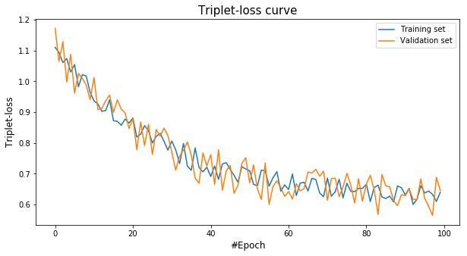
Results
Trained for 100 epochs
6 hours on a K80 GPU
Very slow to train but very stable
No overfitting, could be trained for more

Slide 31
Demo:
At the oral presentation

Slide 32
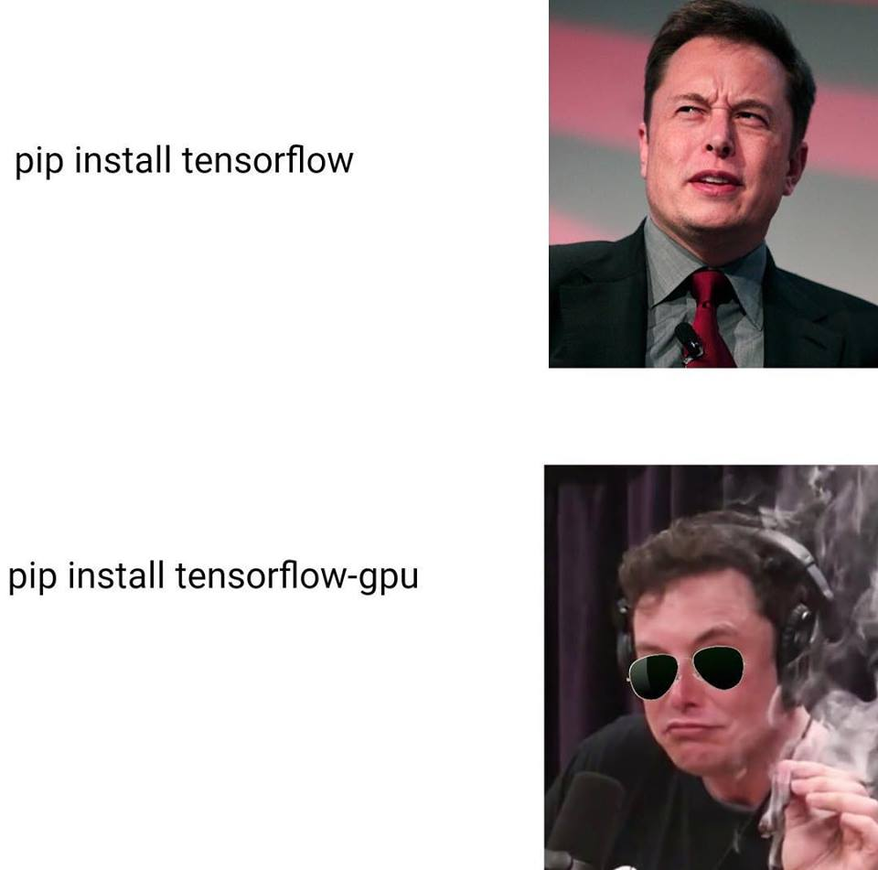
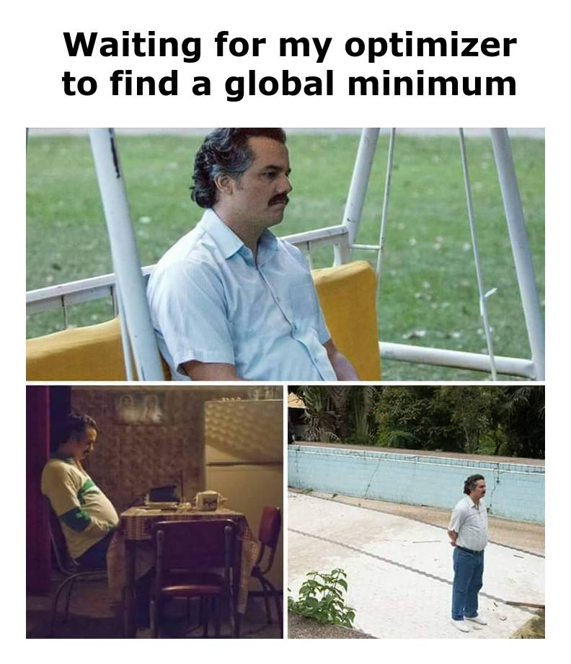
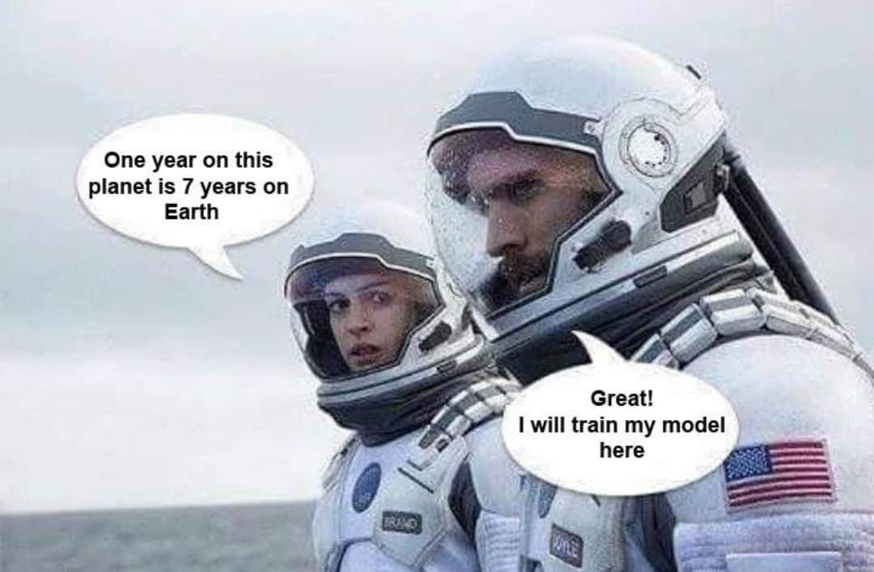

Thank You
for listening!

Slide 33
Thank You

